Slide 1



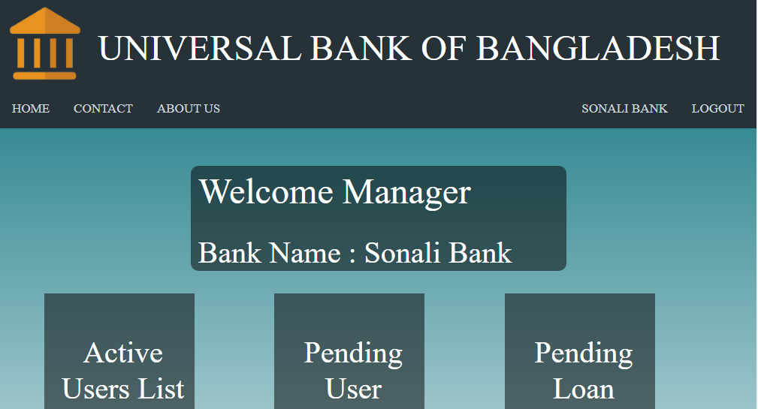
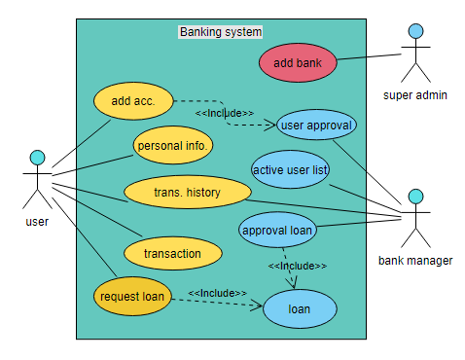
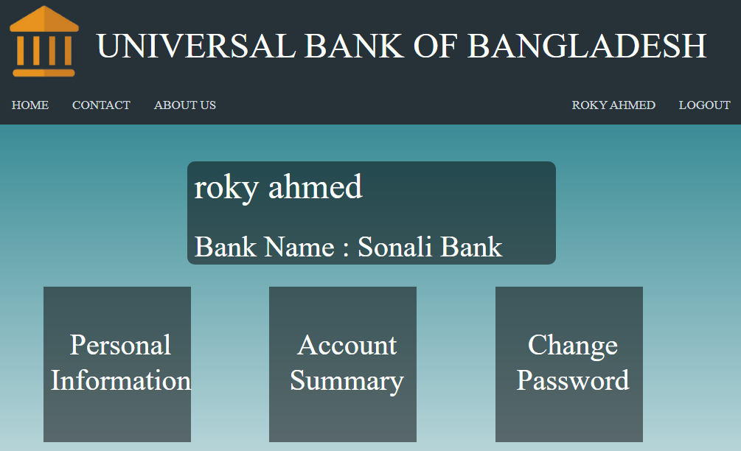
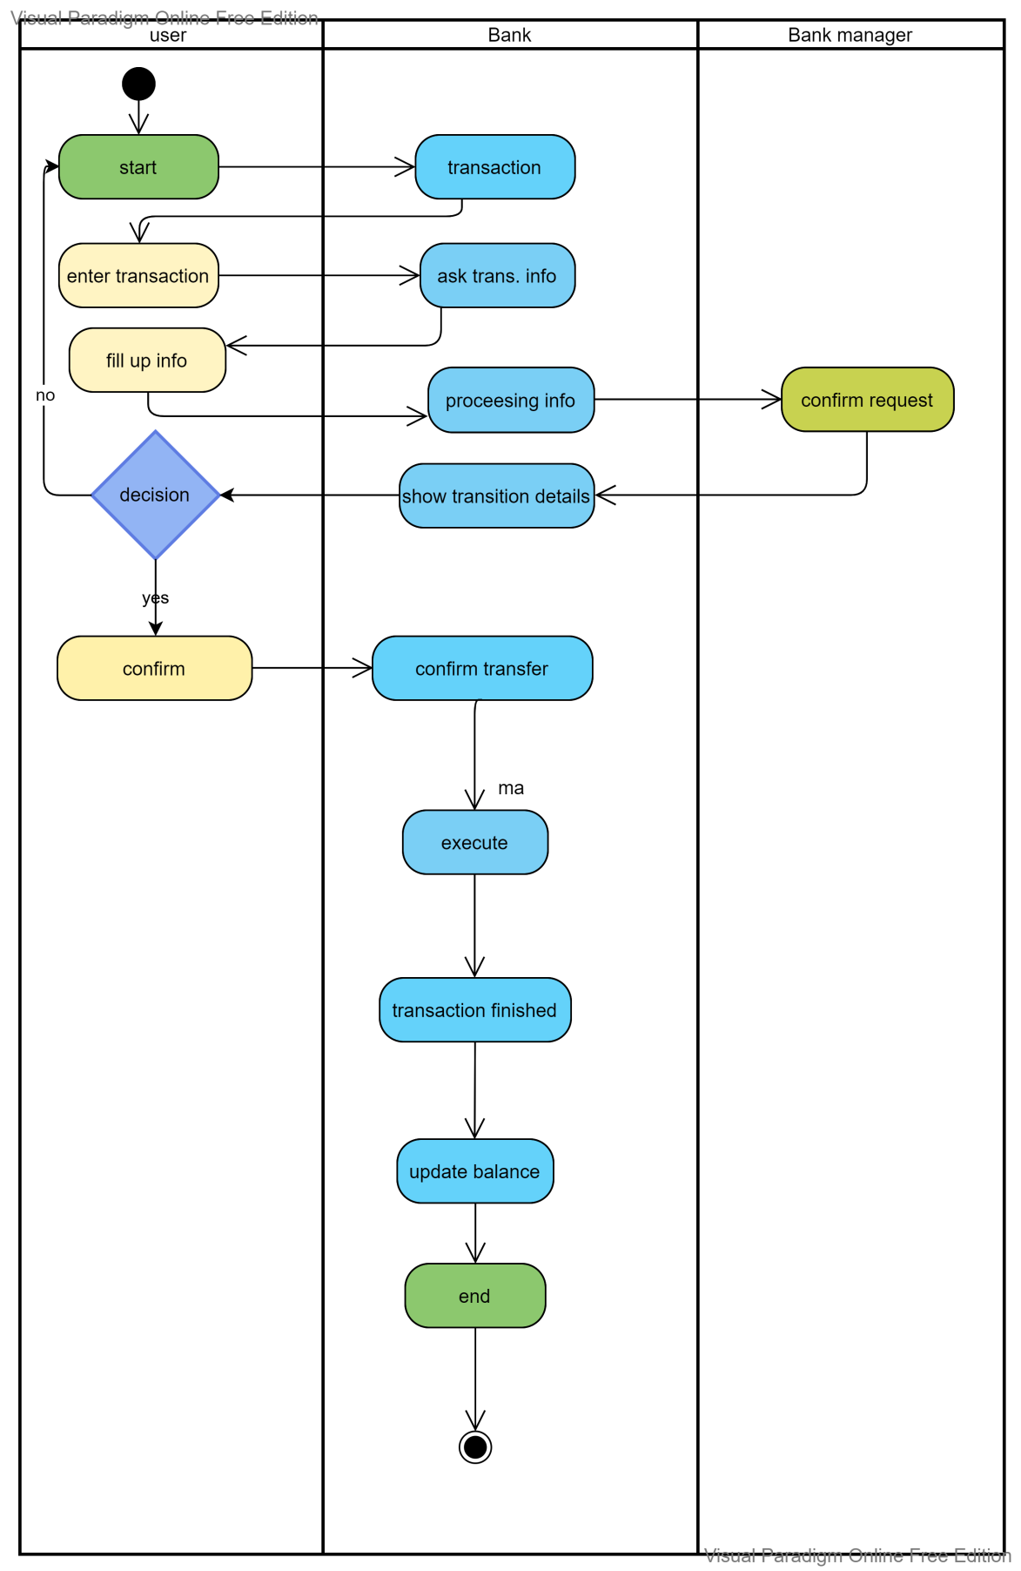
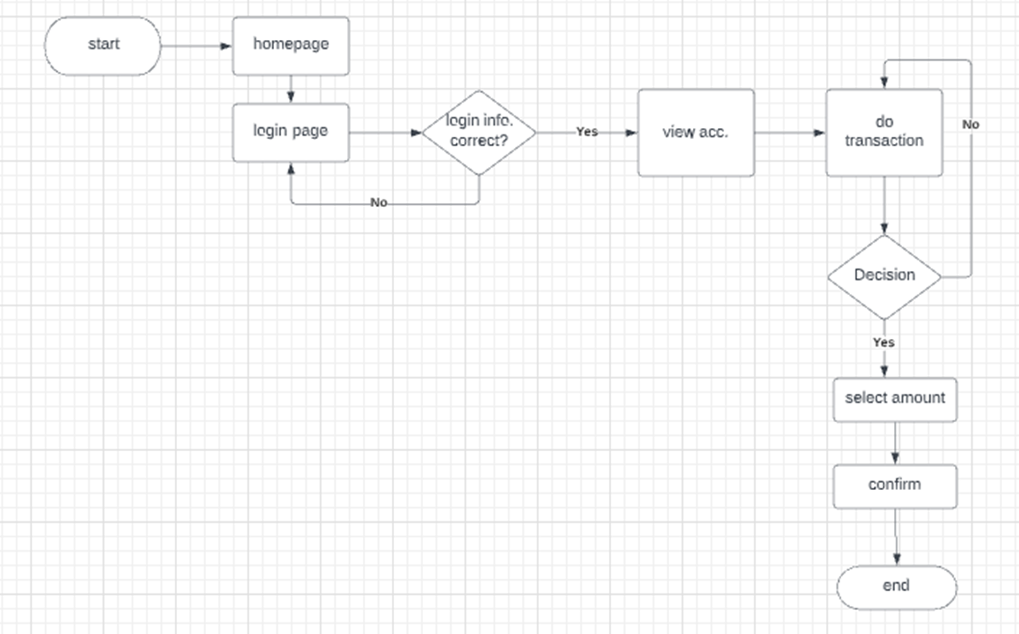
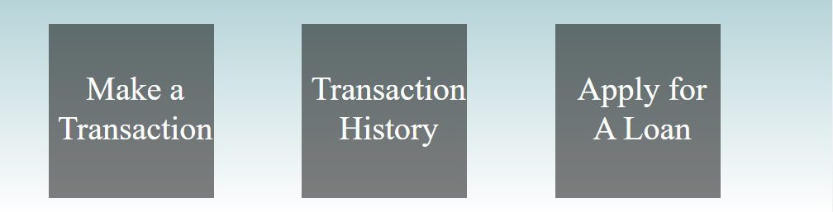
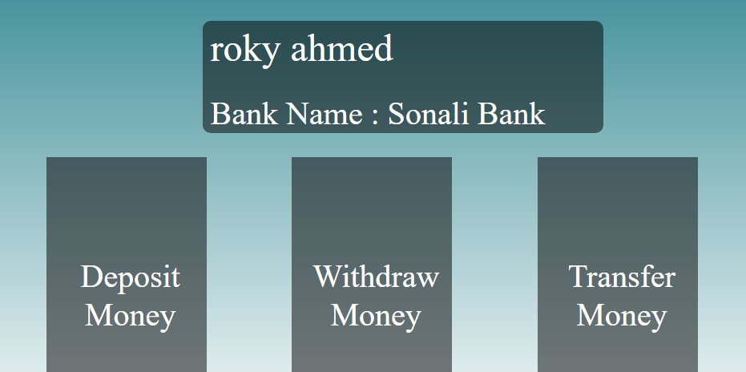
Sazzad Rahman Sagar
Department of computer science and engineering, East West University
Use case diagram
Website info
Banker options
Here we can see the user , bank manager and super admin access to the system.
User Access: Add account, personal info, transaction(withdraw, deposit, transaction).
Bank Manager: User approval, active user list, approval of loan.
Super-Admin: Adding bank and access to all the system.
From here we can see bank manager from different bank can access the user activity list , new user request pending list, pending loan request from the user etc.
Banker can deactivate any user they want and also can undo this action as well.
Activity diagram
User flow diagram
A banking system is a group of institutions that provide financial services for us. These institutions are responsible for operating a payment system, providing loans, taking deposits, and helping with investments.
Online banking allows a user to conduct financial transactions via the Internet. Online banking is also known as Internet banking or web banking. Online banking offers customers almost every service traditionally available through a local branch including deposits, transfers,
Here in this universal banking system all bank user can login to their desired bank and do all the transaction actions they want.
The bank managers can also see their user actions relating to transaction actions, such as loan request, transaction of money etc.
Here user and bank manger both can change their password, can see their own personal info.
To transfer money or to deposit they will need to enter their 4 digit pin.
All the instructions are given with in the input options so that the user can easily do the needful without any time waste.
Here we can see how the bank’s transaction system works
Add your information, graphs and images to this section.

